Slide 1
Deep Learning
Beginnings (sorta)
How it works
Some uses
Notes:
Neural nets
Input hidden middle
1 or more hidden its deep
Approach via vision
Train network on known data (supervised learning)

Slide 2
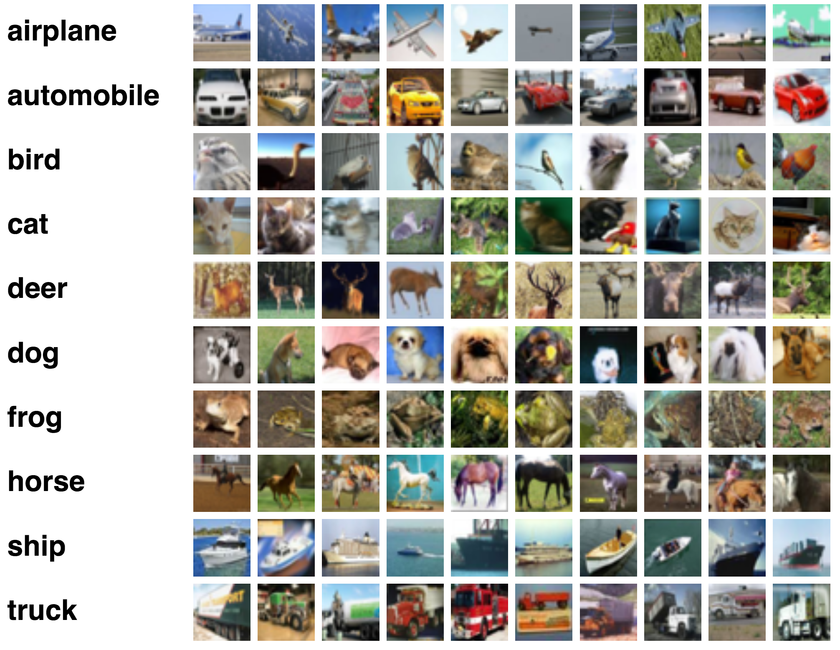
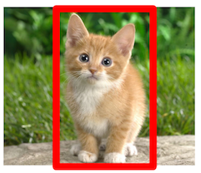
Imagenet 14 million images in 1000 categories
1 million also
Have bounding box data which frames object
Imagenet
Notes:
2006 Fei fei lie-stanford
14 mil images in 1000 categories
At least 1 mil images have bounding boxes (x,y, height width) squares that frame the object
"balloon" or "strawberry", contains several hundred images
Others:pascalVOC, MSCoco…other specialized NIH medical images

Slide 3
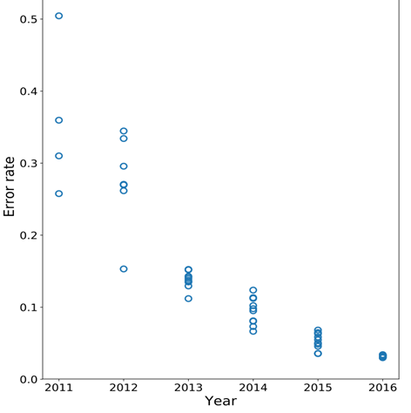
ImageNet Large Scale Visual Recognition Challenge
10 point difference between winner and everyone else!
Notes:
Krizhevsky, Sutskever, and Hinton in 2012 was the coming out party for CNNs in the computer vision community
Harnessed power of conv nets and ability of a GPU to do huge matrix manips
You see that was what was holding NN beack, a lack of horsepower

Slide 4
ImageNet Large Scale Visual Recognition Challenge
From then on everyone used convolutional neural networks
Notes:
From then on every team used deep learning
Started the ball rolling
lead to paper all vision should be deep learning
Bit of a kerfuffle amongst vision people, Gotta forget it all and start over?
Mostly Yep you do

Slide 5
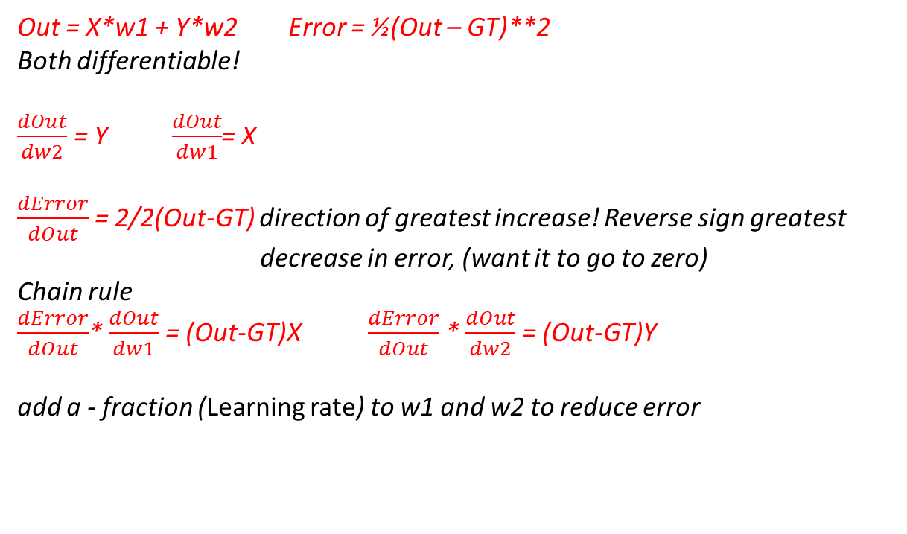
How it works – single neuron
If X=2 and Y=3 and GT= 6 how would you calculate w1 and w2?
X
w1
Error (How wrong is it?)
+
Out
½(Out-GT)**2
Y
w2
Out = X*w1 + Y*w2 Error = ½(Out – GT)**2
Both differentiable!
$\frac{dOut}{dw2}$ = Y $\frac{dOut}{dw1}$= X
$\frac{dError}{dOut}$= 2/2(Out-GT) direction of greatest increase! Reverse sign greatest decrease in error, (want it to go to zero)
Chain rule
$\frac{dError}{dOut}$* $\frac{dOut}{dw1}$ = (Out-GT)X $\frac{dError}{dOut}$* $\frac{dOut}{dw2}$ = (Out-GT)Y
add a - fraction (Learning rate) to w1 and w2 to reduce error
Notes:
Neuron
As long as they are all differentiable! Use partial derivatives and
the chain rule to find way to adjust w1 and w2 to satisfy equation
See http://colah.github.io/posts/2015-08-Backprop/
Partial derivative - the partial derivative with respect to x gives the rate of change of f in the x direction (greatest rate of change) add – greatest decrease

Slide 6
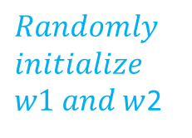
How it works – forward 1
If X=2 and Y=3 and GT= 6 how would you calculate w1 and w2?
2
0.2
Error (How wrong is it?)
$$Randomly$$
$$initialize$$
$w1 and w$2
+
1.299
½(1.299-6)**2 = 11.1
3
0.3
Out = X*w1 + Y*w2 Error = ½(Out – GT)**2
Both differentiable!
$\frac{dOut}{dw2}$ = Y $\frac{dOut}{dw1}$= X
$\frac{dError}{dOut}$= 2/2(Out-GT) direction of greatest increase! Reverse sign greatest decrease in error, (want it to go to zero)
Chain rule
$\frac{dError}{dOut}$* $\frac{dOut}{dw1}$ = (Out-GT)X $\frac{dError}{dOut}$* $\frac{dOut}{dw2}$ = (Out-GT)Y
add a - fraction (Learning rate) to w1 and w2 to reduce error

Slide 7
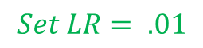
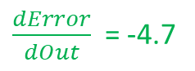
How it works – backward 1
If X=2 and Y=3 and GT= 6 how would you calculate w1 and w2?
2
0.2 –(-4.7*2)*.01
Error (How wrong is it?)
$$Set LR= .01$$
$\frac{dError}{dOut}$ = -4.7
+
11.05
3
0.3 –(-4.7*3)*.01
Out = X*w1 + Y*w2 Error = ½(Out – GT)**2
Both differentiable!
$\frac{dOut}{dw2}$ = Y $\frac{dOut}{dw1}$= X
$\frac{dError}{dOut}$= 2/2(Out-GT) direction of greatest increase! Reverse sign greatest decrease in error, (want it to go to zero)
Chain rule
$\frac{dError}{dOut}$* $\frac{dOut}{dw1}$ = (Out-GT)X $\frac{dError}{dOut}$* $\frac{dOut}{dw2}$ = (Out-GT)Y
add a - fraction (Learning rate) to w1 and w2 to reduce error
Notes:
backpropegation

Slide 8
How it works – forward 2
If X=2 and Y=3 and GT= 6 how would you calculate w1 and w2?
2
0.294
Error (How wrong is it?)
+
1.911
8.359 (was 11.05)
3
0.441
Out = X*w1 + Y*w2 Error = ½(Out – GT)**2
Both differentiable!
$\frac{dOut}{dw2}$ = Y $\frac{dOut}{dw1}$= X
$\frac{dError}{dOut}$= 2/2(Out-GT) direction of greatest increase! Reverse sign greatest decrease in error, (want it to go to zero)
Chain rule
$\frac{dError}{dOut}$* $\frac{dOut}{dw1}$ = (Out-GT)X $\frac{dError}{dOut}$* $\frac{dOut}{dw2}$ = (Out-GT)Y
add a - fraction (Learning rate) to w1 and w2 to reduce error
Notes:
Lets do it again to get closer

Slide 9
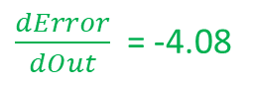
How it works – backward 2
If X=2 and Y=3 and GT= 6 how would you calculate w1 and w2?
2
0.2 –(-8.18)*.01
Error (How wrong is it?)
$$Set LR= .01$$
$\frac{dError}{dOut}$ = -4.08
+
8.359
3
0.3 –(-12.26)*.01
Out = X*w1 + Y*w2 Error = ½(Out – GT)**2
Both differentiable!
$\frac{dOut}{dw2}$ = Y $\frac{dOut}{dw1}$= X
$\frac{dError}{dOut}$= 2/2(Out-GT) direction of greatest increase! Reverse sign greatest decrease in error, (want it to go to zero)
Chain rule
$\frac{dError}{dOut}$* $\frac{dOut}{dw1}$ = (Out-GT)X $\frac{dError}{dOut}$* $\frac{dOut}{dw2}$ = (Out-GT)Y
add a - fraction (Learning rate) to w1 and w2 to reduce error

Slide 10
How it works – forward 100
If X=2 and Y=3 and GT= 6 how would you calculate w1 and w2?
2
.923
Error (How wrong is it?)
+
5.996
~0
3
1.384
Out = X*w1 + Y*w2 Error = ½(Out – GT)**2
Both differentiable!
$\frac{dOut}{dw2}$ = Y $\frac{dOut}{dw1}$= X
$\frac{dError}{dOut}$= 2/2(Out-GT) direction of greatest increase! Reverse sign greatest decrease in error, (want it to go to zero)
Chain rule
$\frac{dError}{dOut}$* $\frac{dOut}{dw1}$ = (Out-GT)X $\frac{dError}{dOut}$* $\frac{dOut}{dw2}$ = (Out-GT)Y
add a - fraction (Learning rate) to w1 and w2 to reduce error
Notes:
After a lot of training
Now get rid of error function
And you have a network that will give the right answer
But want it to give right answer for hundreds of diff inputs
Single neuron does not do this well

Slide 11
How it works – at scale
Most models have thousands of neurons and 100s of millions of parameters (like w1 and w2)
So there are lots of forward and backwards computations
GPUs do most of the calculations using huge multidimensional matrices
Notes:
Want to adjust weights so model generalizes

Slide 12
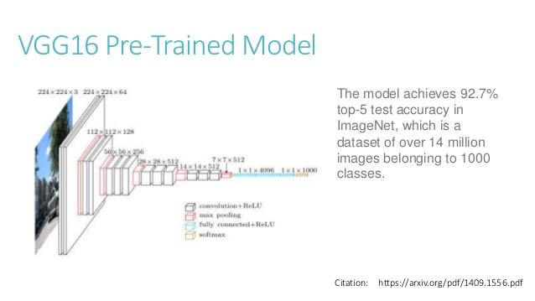
What’s a Model?
A pretrained Neural Network.
Each layer consists of hundreds of convolutional filters which are in turn built from neurons
Each layer connected to next layer
There are a bunch of these pretrained models, useful for ‘transfer learning’ which is coming up
Notes:
VGG16, 19 and other varients, resnet, squeezenet, resnext…. Lots of these

Slide 13
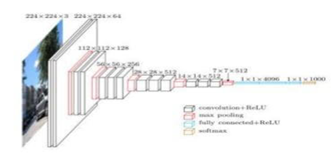
Training, Testing
Need: Data, Architecture (model), Error Function
Train
Define an Error function
Feed images through, error is difference between what model thinks image is verses what the image actually is
Backpropegate to reduce this error
Do this lots of times
Eventually error is low for images, ignoring overfitting, model should generalize and recognize new images similar to old
Test
Feed previously unseen images to model, see if it predicts correctly
Notes:
Batches not single images
Millions, go through entire dataset over and over
Takes days or weeks
Lot of details left out

Slide 14


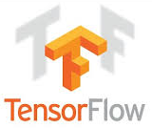
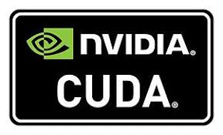


Frameworks do the heavy lifting
Use CUDA drivers to run on GPU (fast)
Or can run on CPU (slow)
See https://en.wikipedia.org/wiki/Comparison_of_deep_learning_software for others
Notes:
Includes lots of networks
Auto handles forward and backward prop
Lots of sample apps
Show some of libraries,
Emphasize the big ones
Mxnet was very hard to use because of terrible documentation, better now I hear with gluon
nVidia CUDA is what they all use to access the GPU, and right now nVidia is the only game in town, no AMD

Slide 15
What can DL do?
It is not Artificial General Intelligence (AGI)! But can handle defined problems in:
Sequential Data (speech, character) recognition, prediction, translation, rudimentary comprehension in the form of sentiment analysis
Time series structured data- A big deal. Analyzing data, predicting outcomes. (in store sales, failure prediction, cancer datasets)
Reinforcement Learning – learning from the environment (AlphaGo, Atari)
Computer Vision (CV)
Notes:
Recurrent Neural Networks, LSTMs, movie recommender (Netflix)
Normalized database - flatfile
Lags, convert categories to embeddings (mini neural net that relates category members) other data to continuous vars, send thru a fully connected neural net
OpenAI gym – toolkit for testing Reinforcement algos
Often front end is a conv net but back end is a predictor of next move, use markov chains, follow highest probability to reward

Slide 16
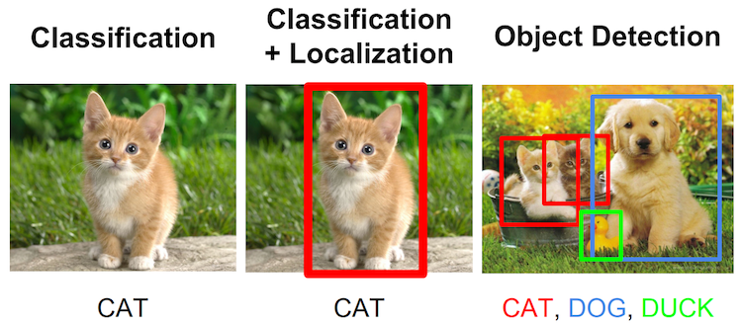
Convolutional Networks
excel in image recognition, segmentation, localization, medical image diagnosis, video manipulation… even art
Stanford cs 231
Notes:
Simple transfer learning to recognize a cat, or a cat and a bounding box

Slide 17
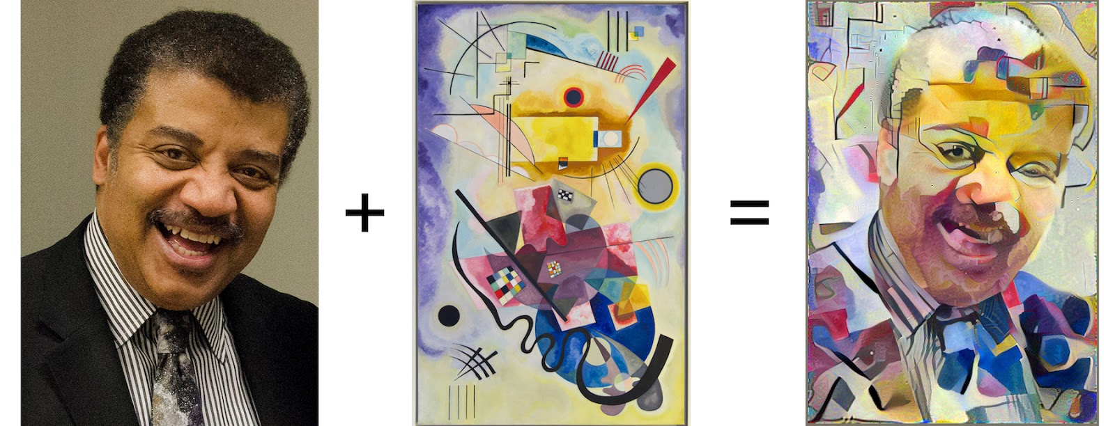
Convolutional Networks
Neural style transfer – error function optimizes image pixels to look like both images on left
http://gurneyjourney.blogspot.com/2016/10/style-transfer.html
Notes:
Neil deGrasse Tyson plus Kandinsky’s Jane Rouge Bleu.

Slide 18
How can I train a model to recognize labeled images I supply?
Called ‘transfer learning’, very common. Take an existing trained model and reuse most of it to recognize something new.
Much faster than training model from scratch
Need a lot less data as well
Works well if the things you want to recognize are similar to the things the model was originally trained on
Load a fully trained model (like VGG16)
Replace the last fully connected (FC) layers with new FC layers that have number of outputs = number of classes you want to distinguish
Train those FC layers only with your training data
Train whole model with your training data
See https://pytorch.org/tutorials/beginner/transfer_learning_tutorial.html
Notes:
IE imagenet trained models are good for dogs, cats. Worse for xrays, may have to retrain earlier layers
Start jupyter notebook
Train it all

Slide 19
DL practitioner skillset 1
Know a bit about GPUs (Nvidia not AMD)
OS - Linux – period. Just enough to get by
Need muscular machine (gamer rig?)
Need more (yes you do) cloud based resources
Amazon, Paperspace, etc. provision a machine, start it up, install software, hmmm.. Sounds hard
So use preconfigured machine instances with all your libraries installed (get your muscle machine for dollars per hour)
Get used to ssh, terminal, and pdb, and some scripting. Or set up a windowing session (X2go, noMachine, TeamViewer) and go with an IDE. Your remote machine can be anything (Mac, Win, Linux)
Get used to Jupyter notebooks ( great to teach, tough to debug, awful in version control)
Git – for everything
Need to know your vector operations (Linear Algebra)
A bit about probability
Notes:
OS – Mostly ubuntu, ask how to run this on Windows and you might be mocked)
Machine - needs to run for days or weeks to train full throttle (hmmm burn out those gamer rig GPUs)
training a model overnight and my GPU was 80 C or 175 F
I have the best gamer GPU Titan black XP and I run out of memory

Slide 20
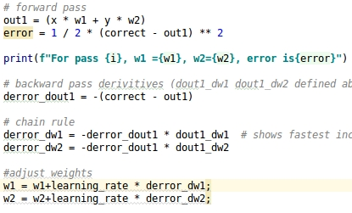
DL practitioner skillset 2
Python – but not like this
Notes:
Well docced simple

Slide 21
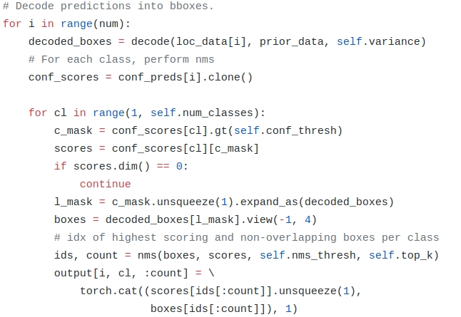
DL practitioner skillset 2
Python –more like this
Notes:
Magic numbers, list comprehension, slices, lots of tensor ops, cuda verses non cuda vars and ops

Slide 22
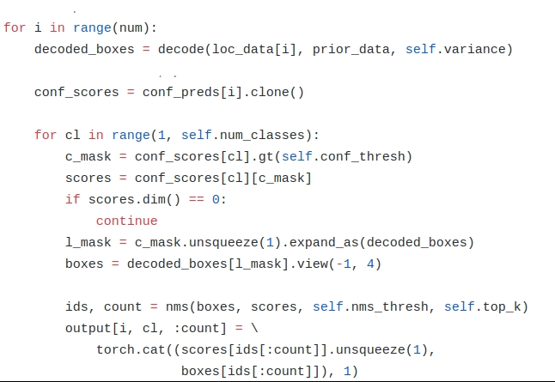
DL practitioner skillset 2
Python –and realistically like this
Lots of beta software
and missing documentation
Heavy use of list
comprehensions, iterators,
generators, matrix
Manipulation

Slide 23



DL practitioner skillset 3
And… need to know data manipulation routines, image formatting, normalization data cleaning, directory and file manipulation…but you pick this up as you go
Notes:
(subtractby mean and divide by standard dev),
imputing missing values based on average or based on multiple columns
I worked on one prob over summer where I had to mask a plant out of thousands of images
much done with openCV, pillow, and Pandas

Slide 24
Why is this hard
When it does not work its hard to troubleshoot 100,000,000 params
Hyperparam selection, learning rate, architecture, FC layer depth
Must find sweet spot where your model generalizes well but does not overfit your data
Split dataset 80% train, 10% test, 10% validation. When accuracy on test set starts to decrease you are probably starting to overfit
Notes:
What to do with high bias
High varience?
Lots of rules of thumb

Slide 25
Why jump on board?
A hot field
Big advances being made with easy ideas
Cyclic learning rates, learning rate finder, focal loss

Slide 26
Interested?
Kaggle – data science competitions
Lots of how-tos, data scrubbing, AI techniques
Both images recognition and structured data
FastAI Get up to snuff fast!
Fastai https://course.fast.ai/
Its free. Teaches coders how to use AI - both machine learning (random forest, boosted trees) and Deep Learning. 24 weeks of state of the art instruction, with a lively forum for support.

